Slide 1


High-throughput exploration of adaptive immune repertoires.
Application to the isolation of bNAbs in HIV infection
Benjamin Nemoz
GRICAD Users day

Slide 2
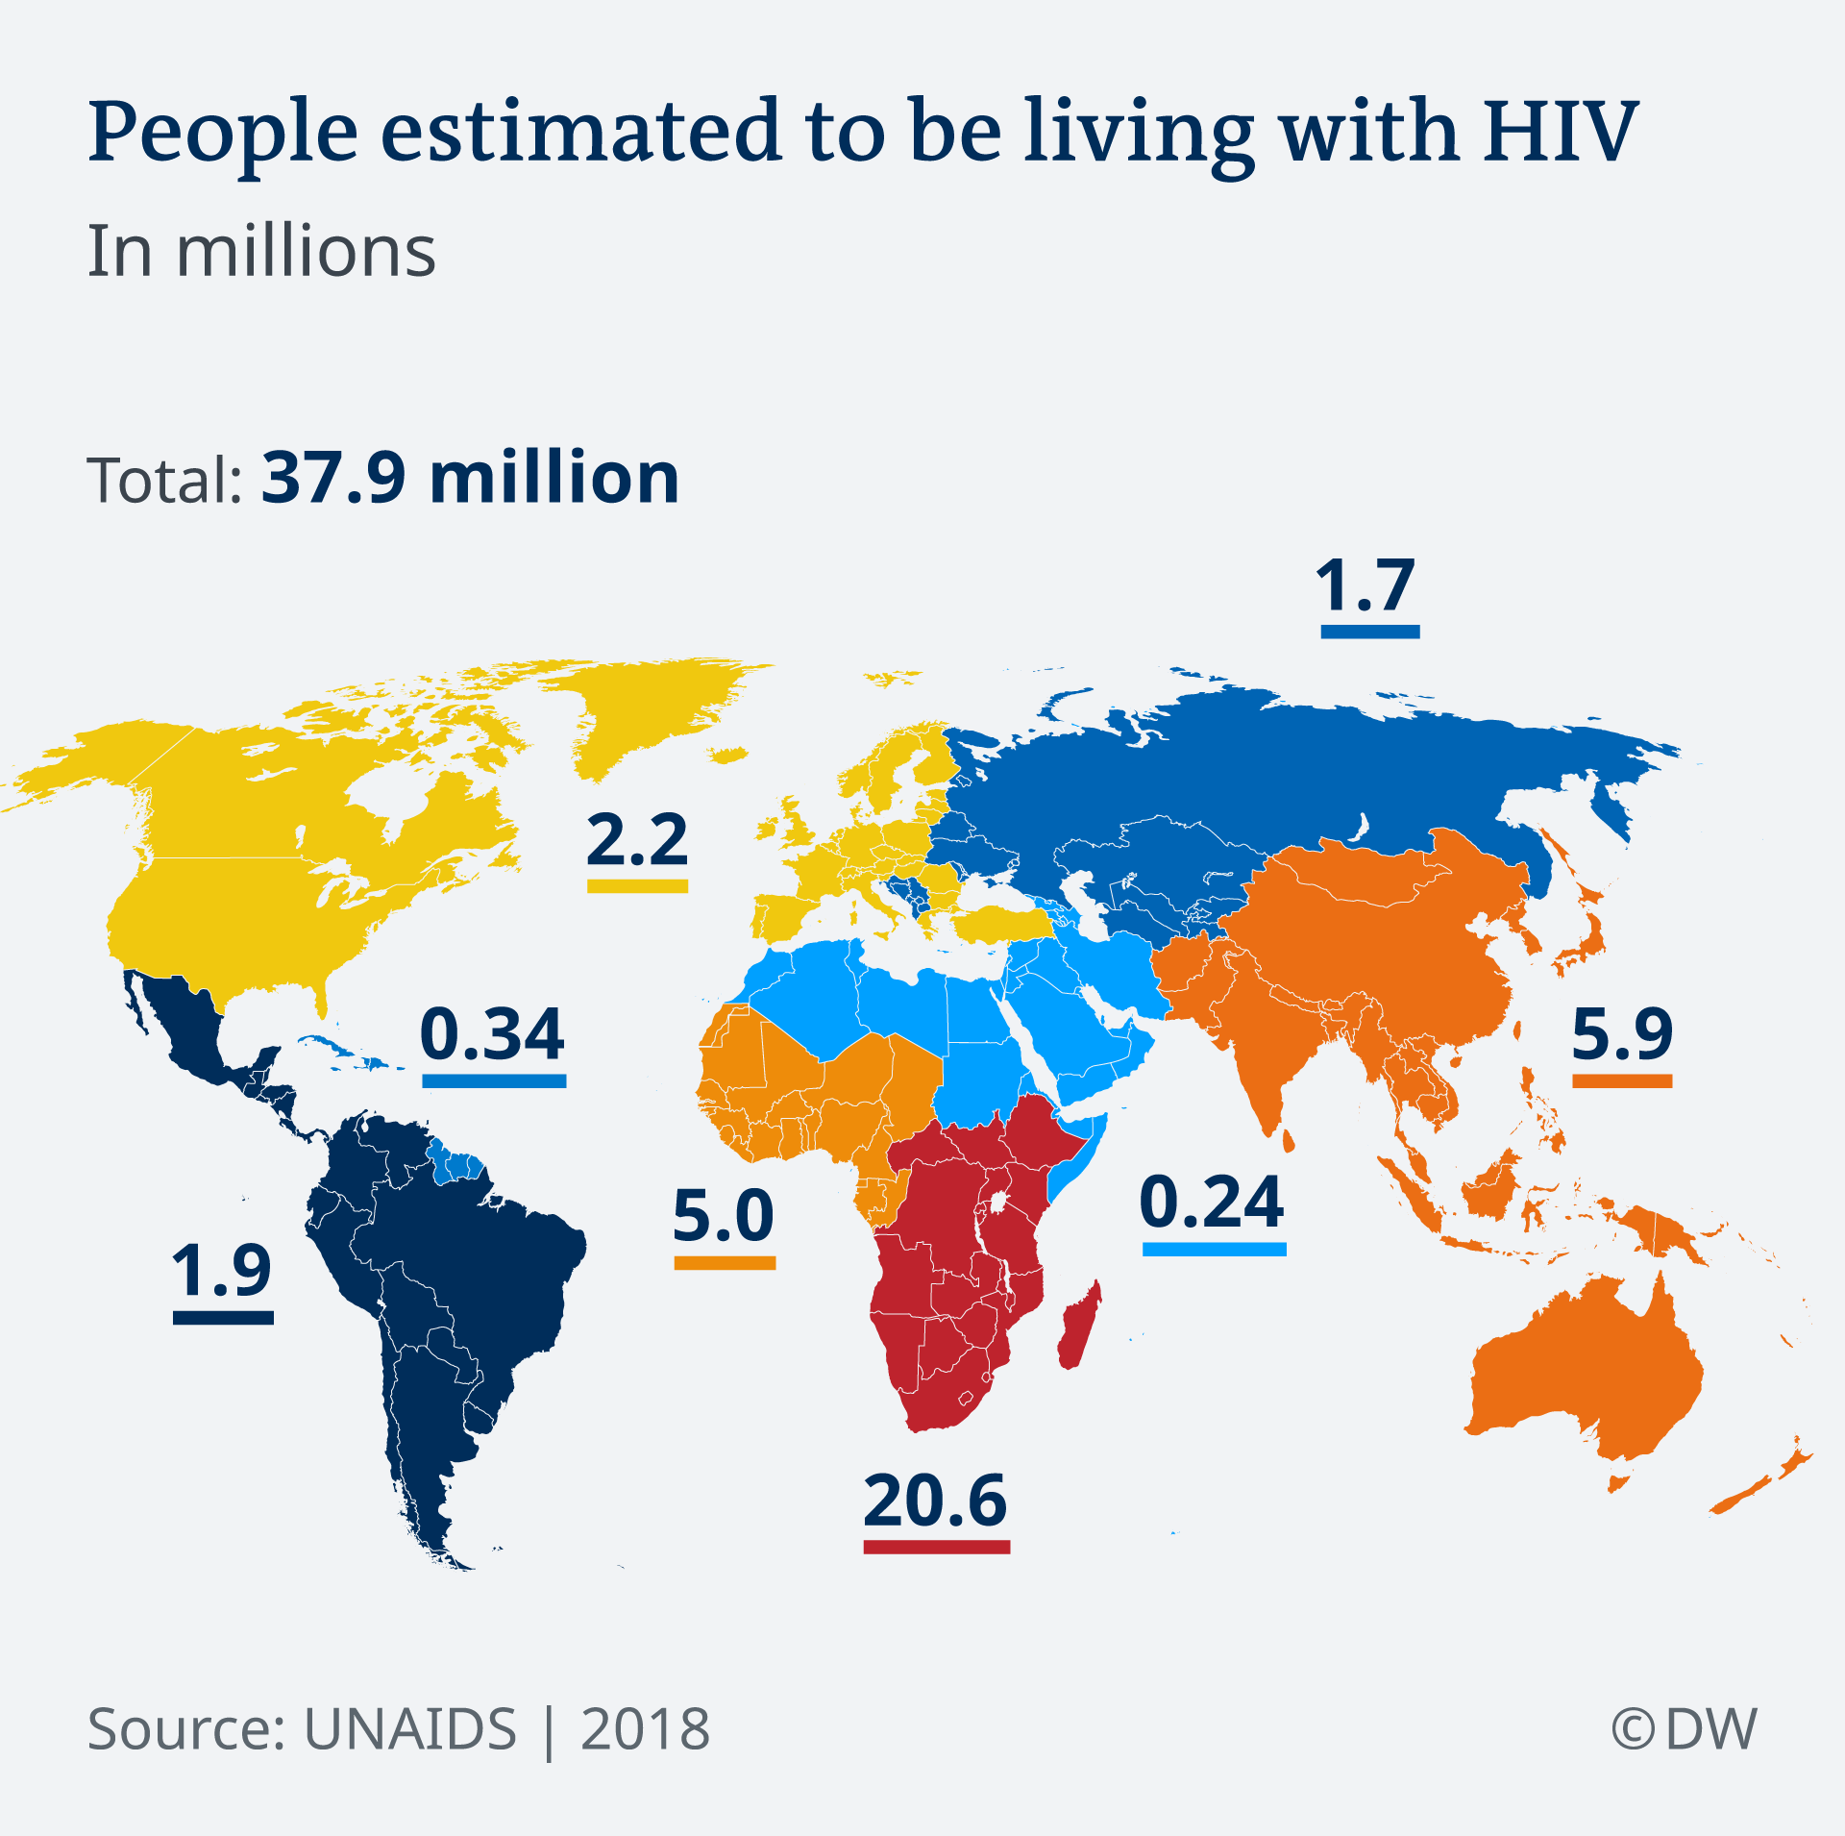
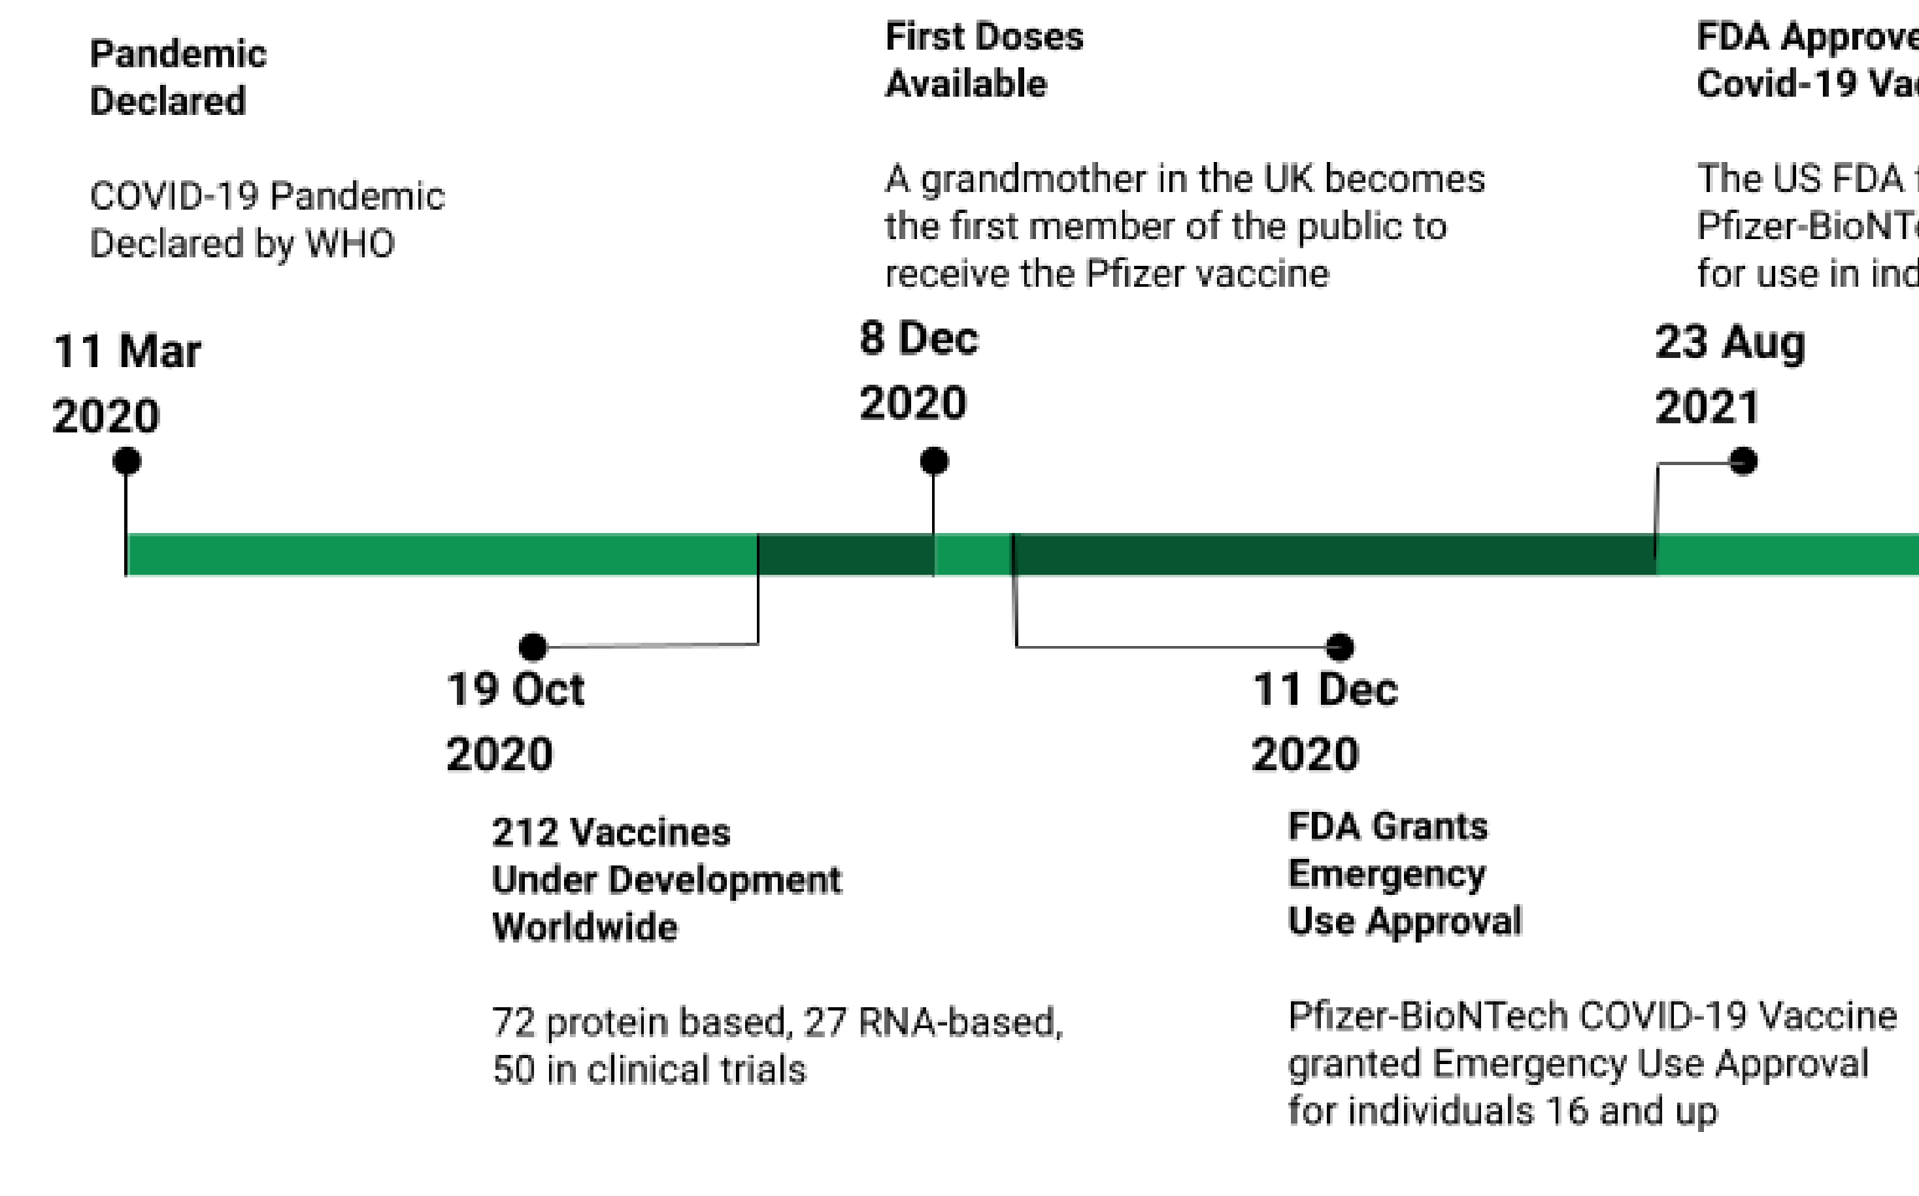
Where is my shot?
COVID-19
HIV | AIDS
Numerous clinical trials wihtout any success
Years 1990-2010
1983
2009
2016
RV144 Trial
31 % efficacy in a Thai clinical trial
HVTN100 Trial
30 % efficacy in subgroups in a South-African cohort

Slide 3
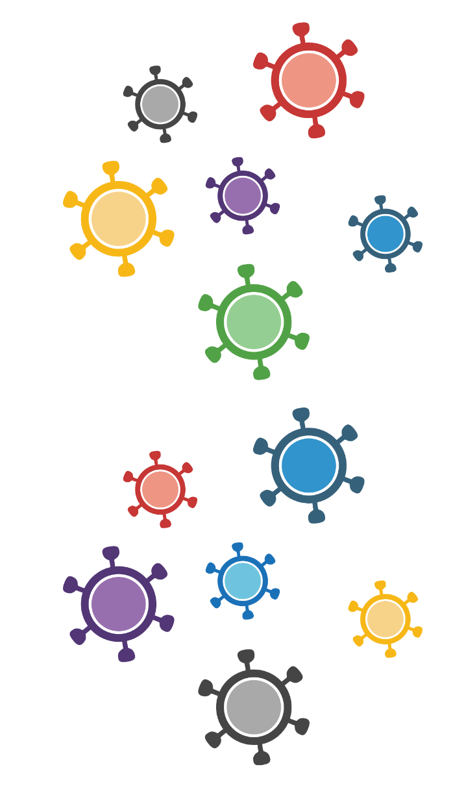
HIV mutates constantly resulting in an extraordinary diversity
HIV virus

Slide 4

Antibodies are generated by our immune system to fight the viral infection
Total antibody diversity is estimated to be around
10¹⁶⁻¹⁸ possibilities
Antibody
Briney et al, Nature 2019 (https://doi.org/10.1038%2Fs41586-019-0879-y)

Slide 5
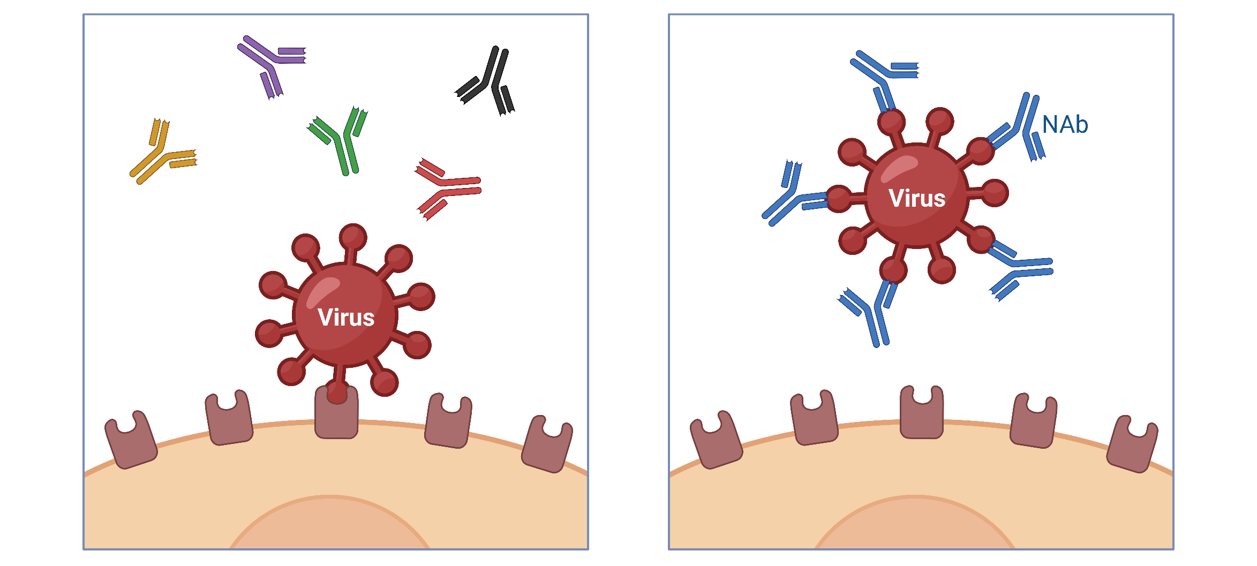
Neutralization is one of the many antibody functions
No Neutralization
Neutralization
Viral receptor
Target cell
Robert-Guroff et al, Nature 1985 (https://doi.org/10.1038/316072a0)

Slide 6
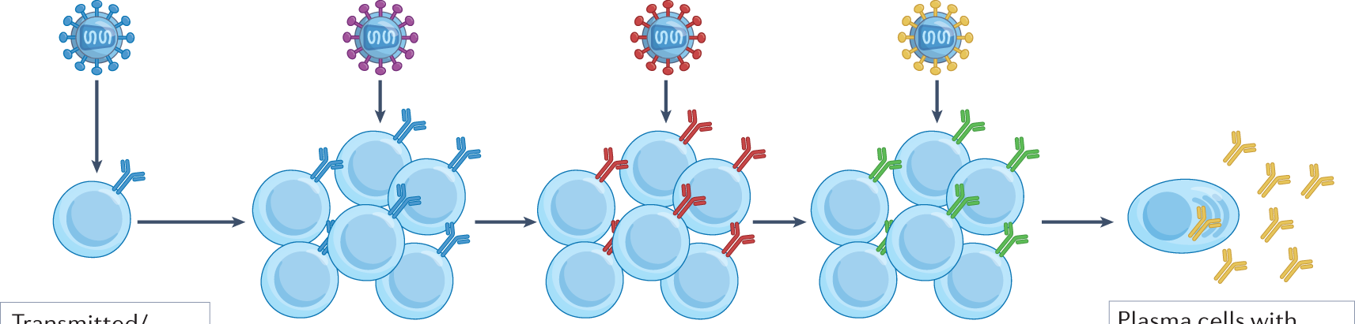
B cells are responsible for antibody production. They constantly evolve to match the circulating virus
Haynes et al, Nat. Immun. Rev. 2023 (https://doi.org/10.1038/s41577-022-00753-w)

Slide 7

Some antibodies are capable of broad neutralization:
They are broadly Neutralizing Antibodies
bNAbs

Slide 8
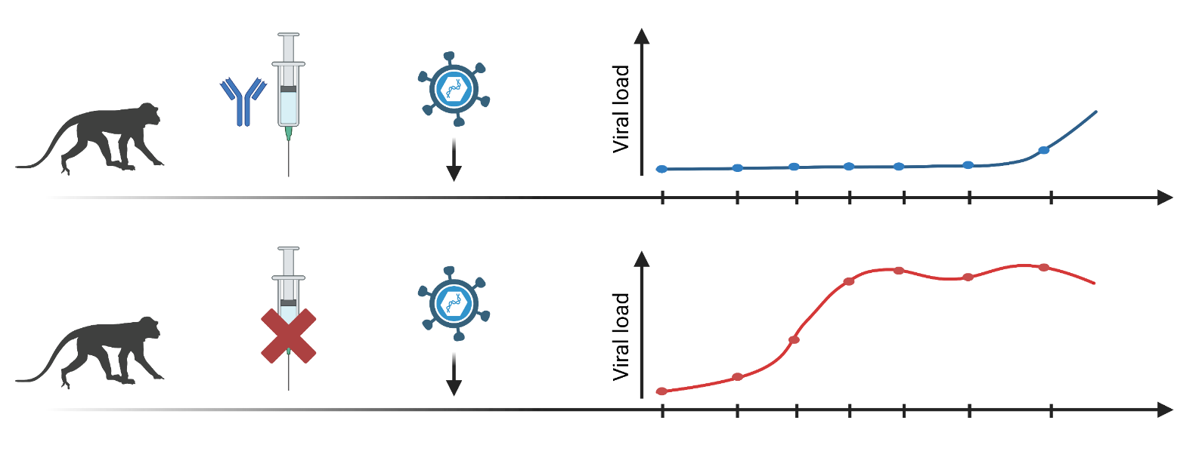

An efficient HIV vaccin can be based on the elicitation of neutralizing antibodies
Passive protection in macaque
Mascola JR et al. Nat Med. 2000 (https://doi.org/10.1038/72318)
Notes:
Passive protection in macaque : au moins Gautam 2018, probablement un autre papier princeps avant Shibata et al. Nature Medecine 1999 (https://doi.org/10.1038/5568) ou Mascola 1999 (J Virol) avec challenge intraveineux
Et chez l’homme aussi, cf sneller 2022

Slide 9
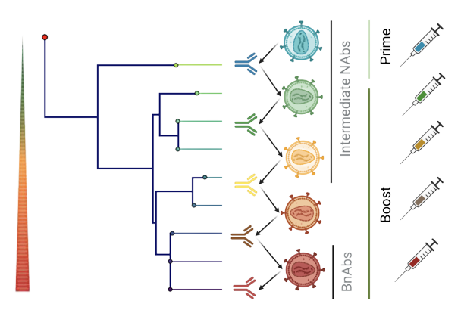
Understanding the evolution of antibodies towards breadth and potency can inform a vaccinal design

Slide 10

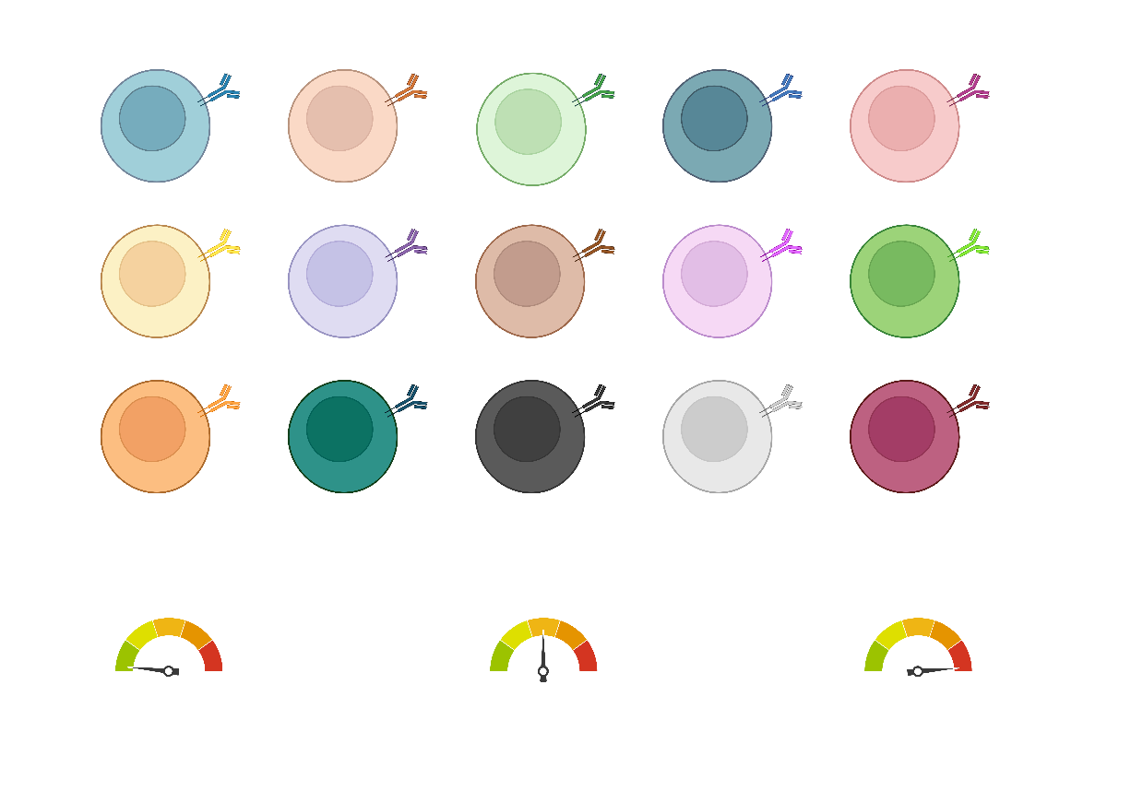






Looking for a needle in a haystack…
?

Slide 11
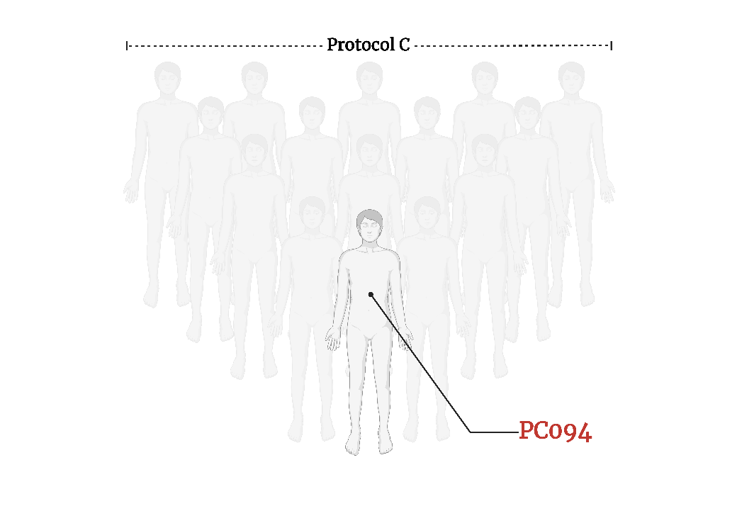
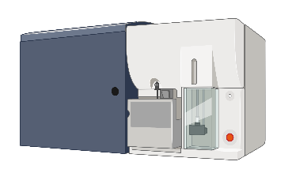
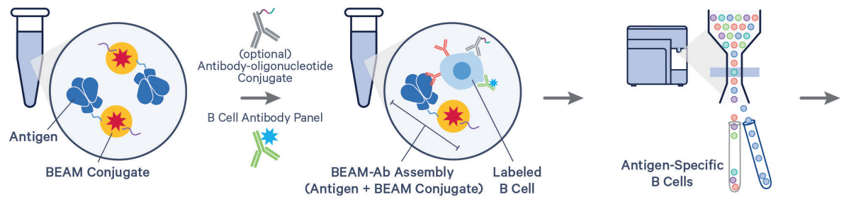
We isolated bNAbs in a top neutralizer donor from the protocol C cohort
Single-cell FACS using multiple HIV Env trimeric baits at multiple timepoints
HIV
infection
18
24
30
36
42
48
54
60
66
72
78
months post infection

Slide 12
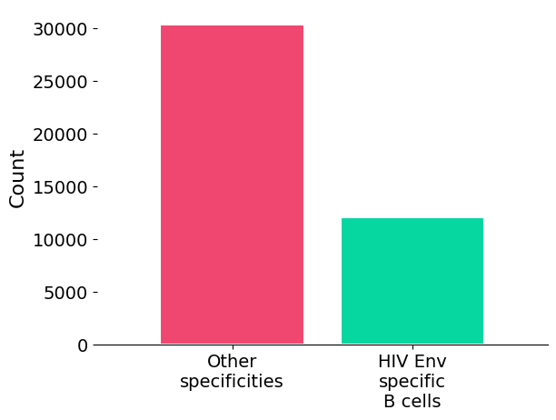
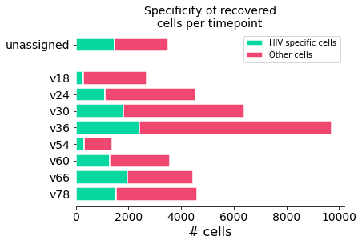
We isolated ~12.000 B cells specific of HIV Env epitopes

Slide 13
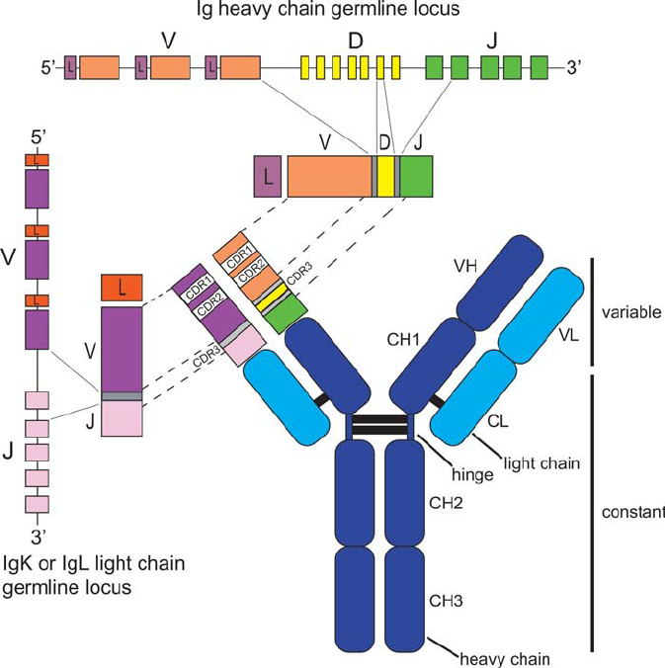
Did you said « antibodies »?
Boyd et al. Microb Spectrum 2014 (https://doi.org/10.1128/microbiolspec.AID-0017-2014)

Slide 14
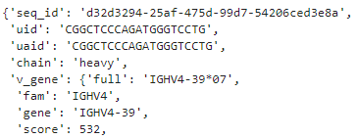
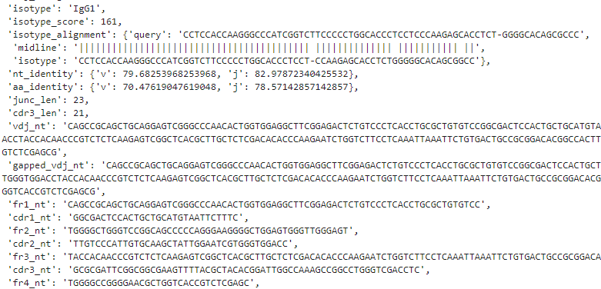
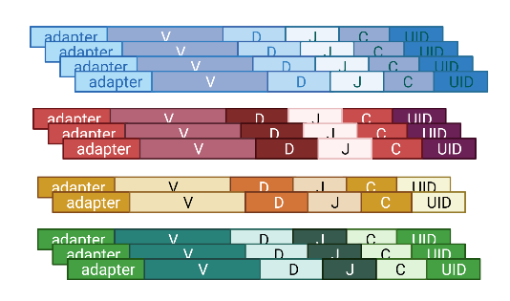
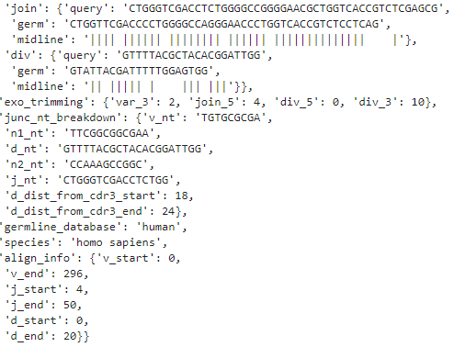
Antibodies are caracterized using AbStar
AbStar
https://github.com/briney/abstar

Slide 15
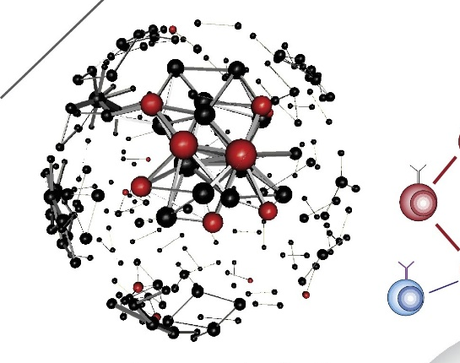
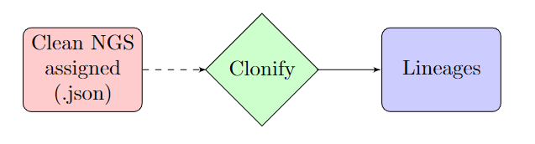
Antibodies are grouped into clonal lineages (families) using Clonify
https://github.com/briney/clonify

Slide 16
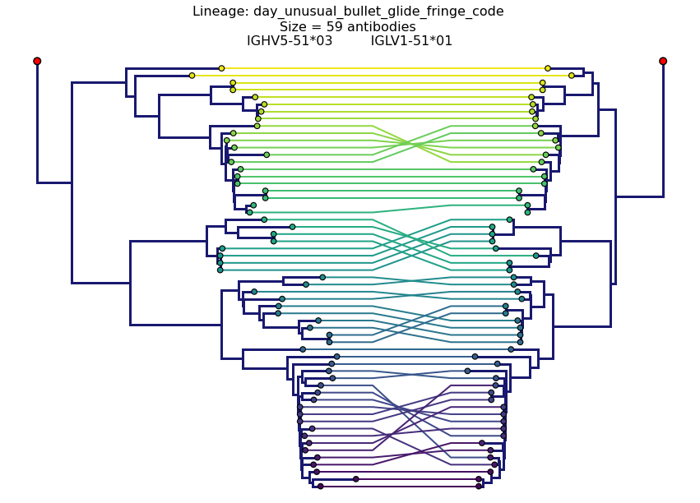
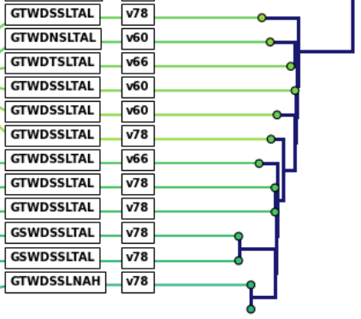
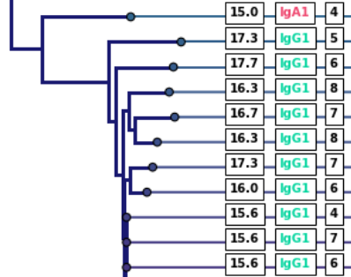
Evolution of antibodies in a single lineage
IGHV5-51*03
IGLV1-51*01
Breadth
Isotype
SHM
CDR(L)3
Timepoint

Slide 17
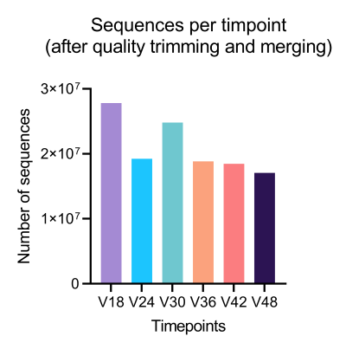
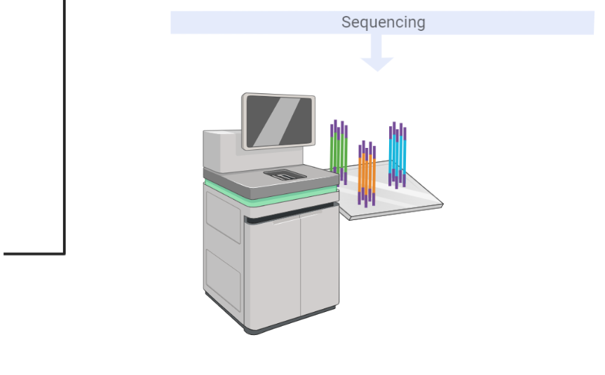
More antibodies !
Illumina NovaSeq 6000
126 227 701
sequences
Only ~50 Go

Slide 18

Antibody assignment has been performed on DAHU
AbStar
Assignment has been performed per timepoint
Time to completion : ~12h/timepoint
(Wall time set at 24h, standard node)
Total output : 1,5 To

Slide 19
Assembling clonal families with Clonify was a daunting task!
Clonify
106 647
Clonal families
126 227 701
Sequences
1,5 To
Clonal families assembling has been performed over the whole dataset
Time to completion : ~40h
(Wall time set at 48h, big node)

Slide 20
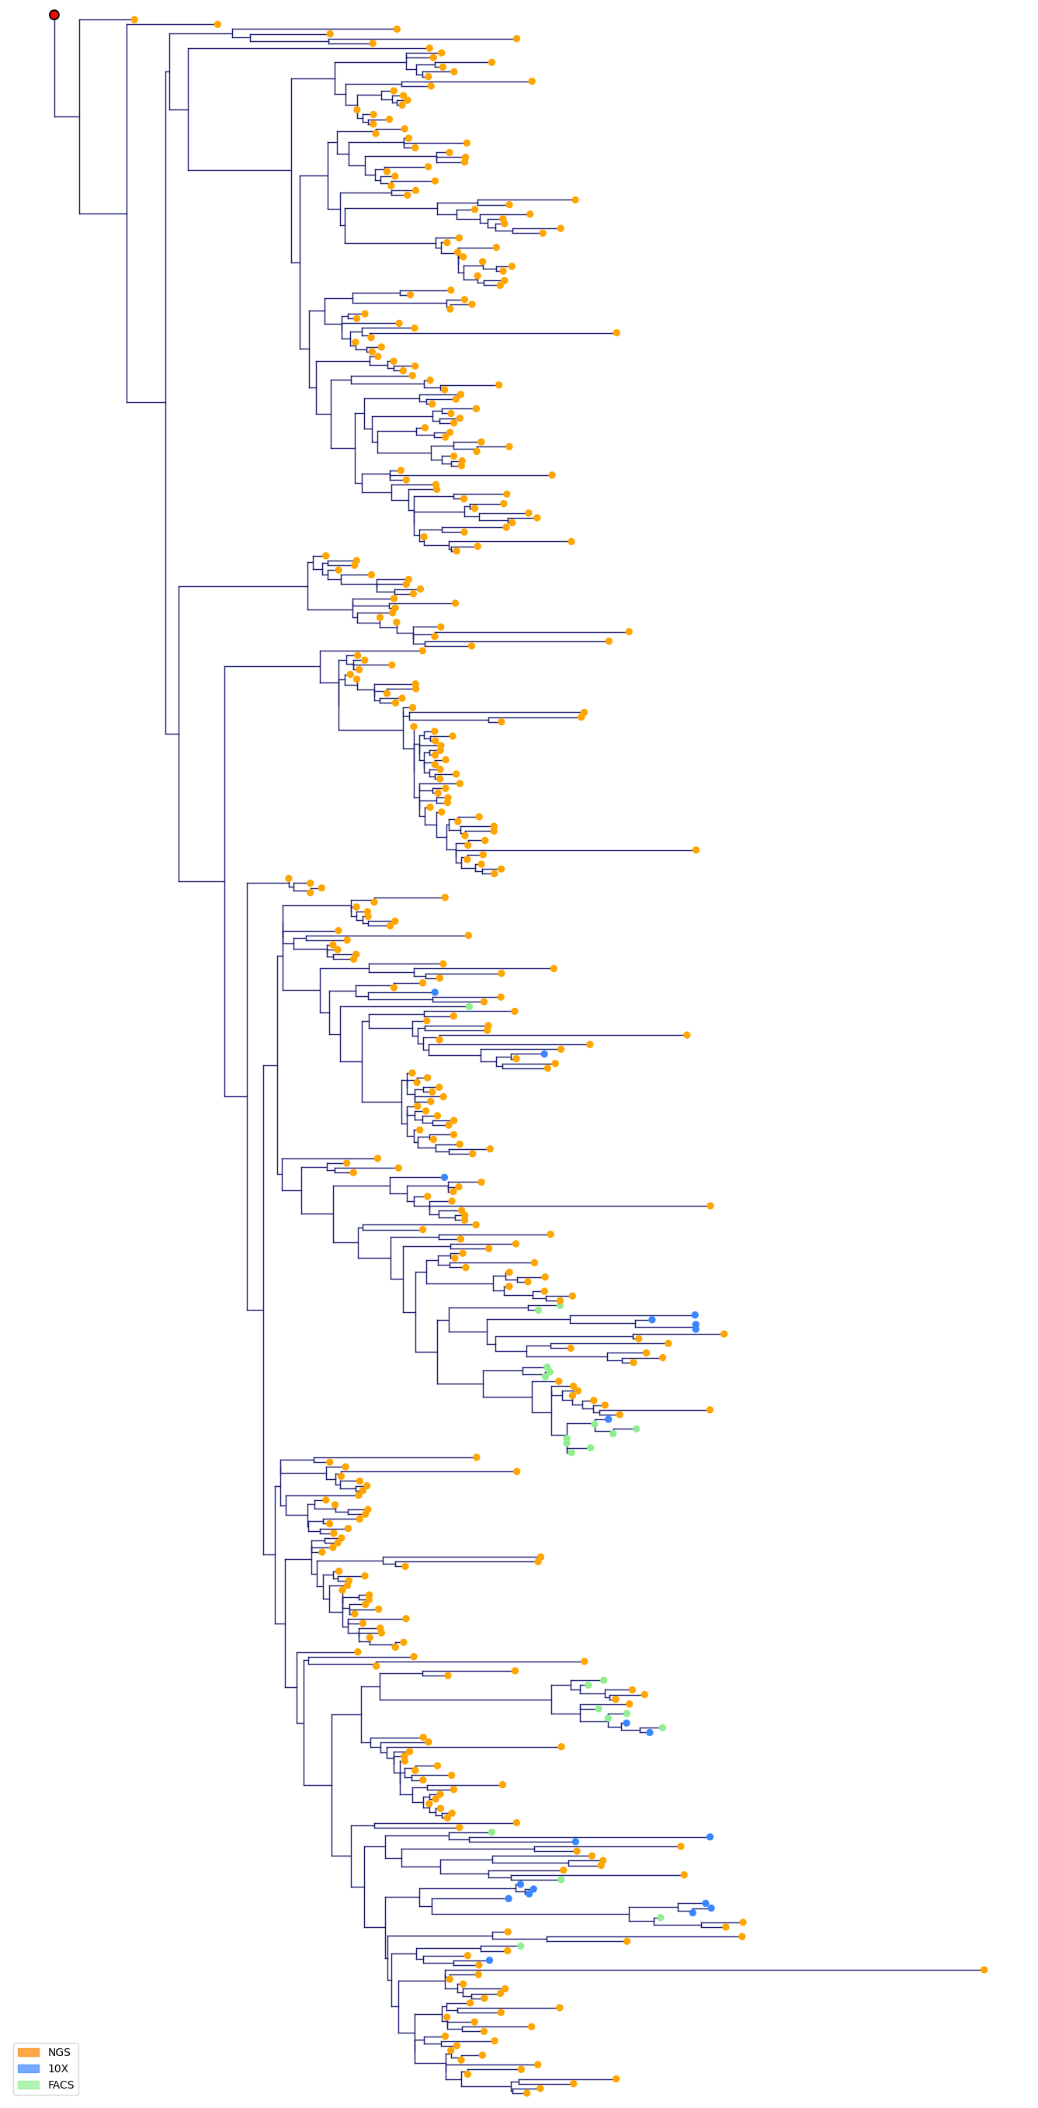

Complete phylogeny of a broadly neutralizing lineage

Slide 21
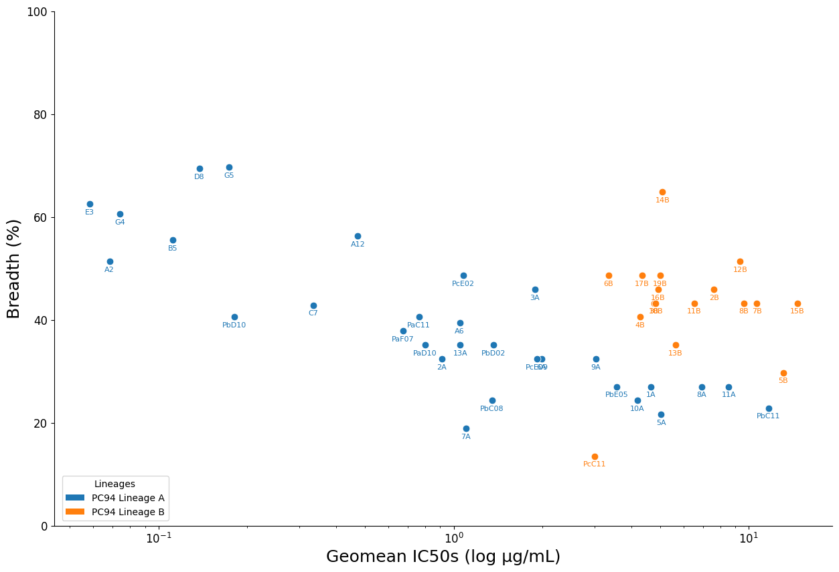
Best antibodies from PC94 can neutralize up to
~70 % of HIV strains tested

Slide 22




Acknowledgments
Poignard Lab
Pascal Poignard
Marlyse Buisson
Isabelle Bally
Sebastian Dylon
Romy Rouzeau
Claire Rousset
Axelle Amen
Laurence Grossi
Giovanna Clavarino
Burton Lab
Dennis Burton
Pilar Altman
Mara Parren
Rebecca Nedellec
Nathan Beutler
Briney Lab
Bryan Briney
Jonathan Hurtado
Terrence Messmer
Pragati Sharma
Andrabi Lab
Raiees Andrabi
Sophie Ge Song
Katharina Dueker
Sean Callaghan
Tazio Capozzola
Sok Lab
Devin Sok
Elise Landais
Romy Rouzeau
Iszac Burton
Claudia Flynn
Katie McKenney
Alison Burns
Ward Lab
Gabriel Ozorowsky
Wilma Lee
Wilson Lab
Rotimi Omorodion
GRICAD Pierre-Antoine Bouttier

Slide 23
Thanks for your attention !

Slide 25
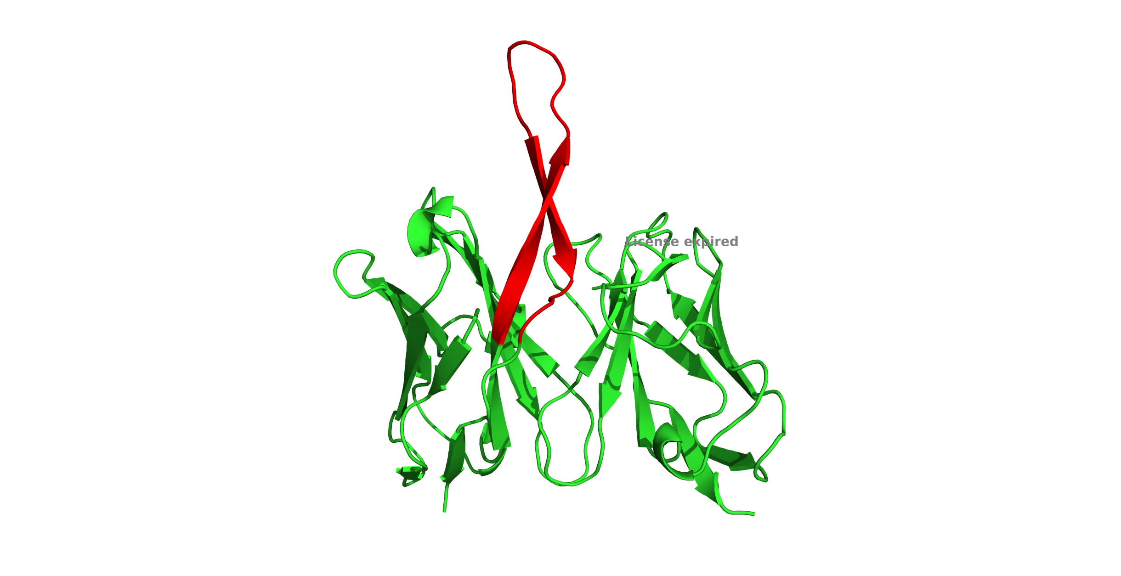
Structure of antibodies is key to their function

Slide 26
PC94 is one of the top neutralizers of a longitudinal primary HIV infection cohort :
PC94
1
2
3
Courtesy R Rouzeau

Slide 27
Broad neutralizing specificity is directed towards the V3 loop / high manose region of gp120
Conserved region
HIV ENV Trimer
HM Patch
PC94
1
2
Viral membrane
3
Courtesy R Rouzeau

Slide 28
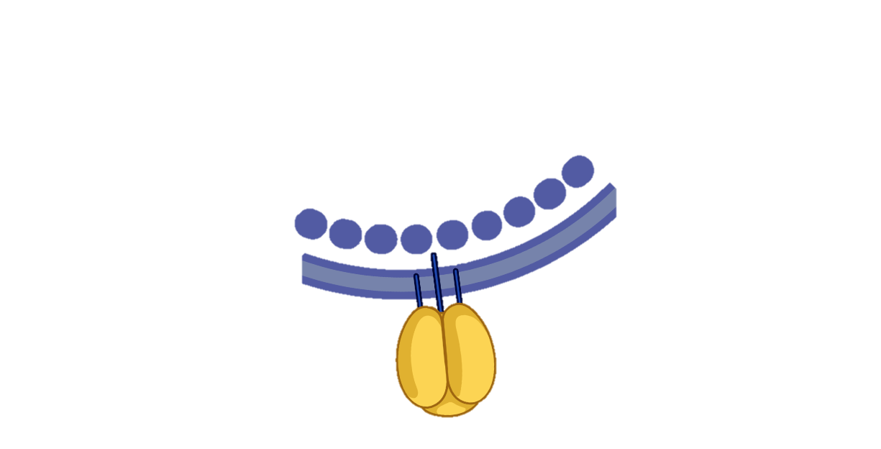
Broad neutralizing specificity is directed towards the V3 loop / high manose region of gp120
Conserved region
HIV ENV Trimer
HM Patch
PC94
1
2
Viral membrane
3
Courtesy R Rouzeau

Slide 29
Broad neutralizing specificity is directed towards the V3 loop / high manose region of gp120
Conserved region
HIV ENV Trimer
HM Patch
PC94
1
2
Viral membrane
3
Courtesy R Rouzeau

Slide 30
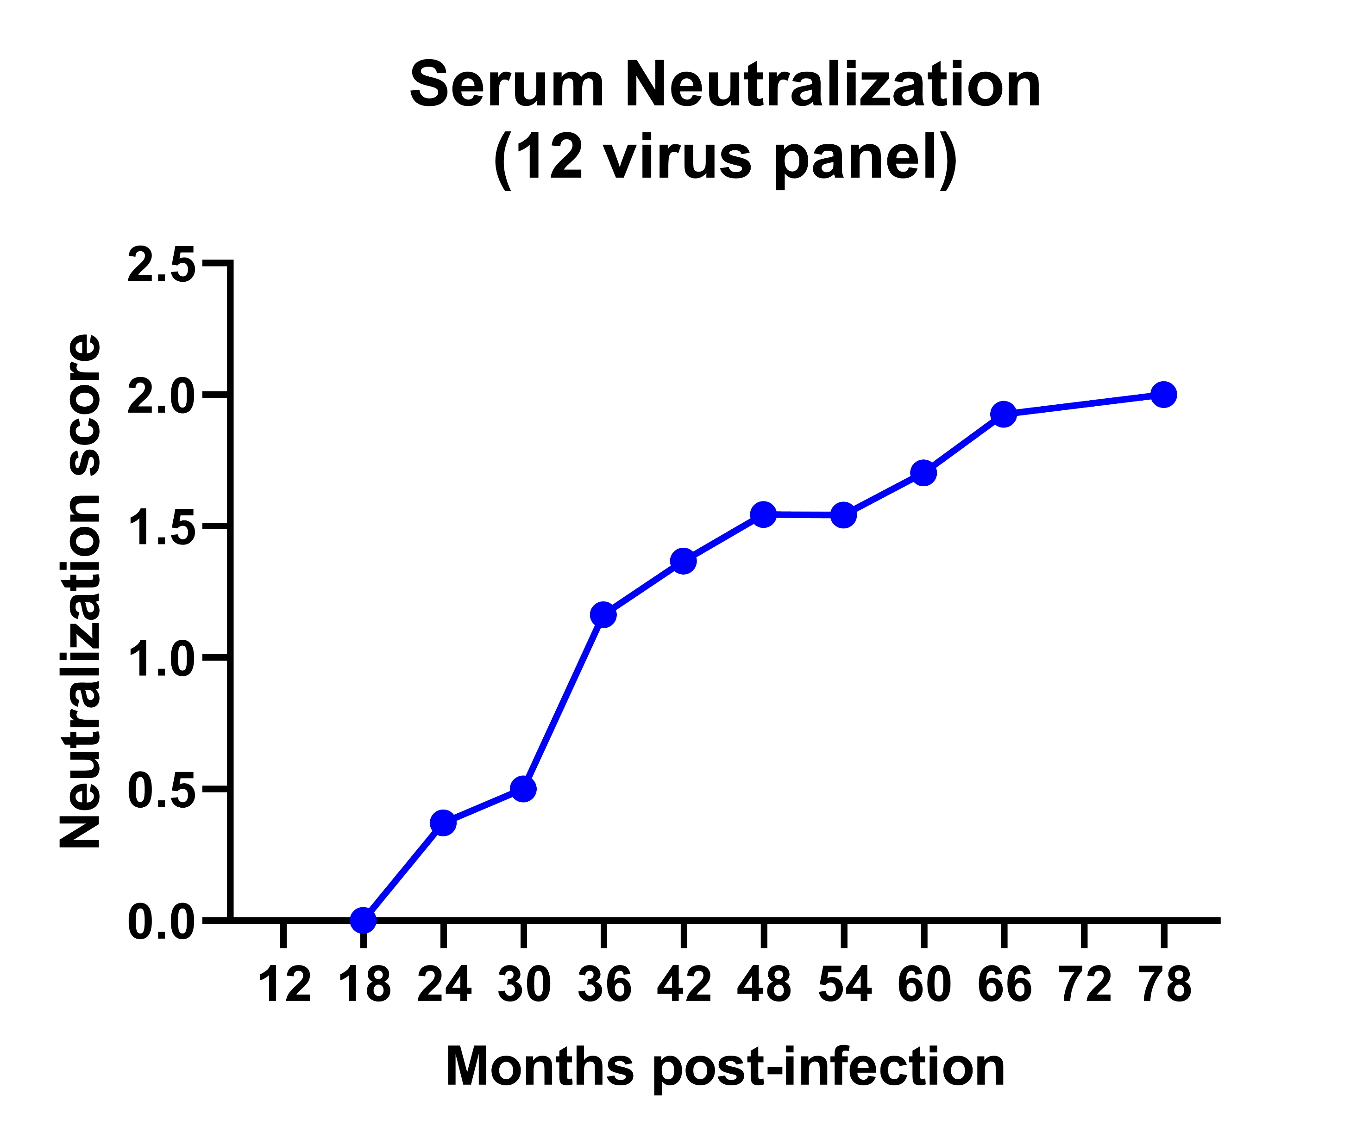
Isolating broadly neutralizing antibodies from longitudinal PC94 samples
PC94
1
2
3

Slide 31
Isolating broadly neutralizing antibodies from longitudinal PC94 samples
PC94
1
2
3
HIV
infection
18
24
30
36
42
48
54
60
66
72
78
months post infection

Slide 32
Isolating broadly neutralizing antibodies from longitudinal PC94 samples
HIV
infection
18
24
30
36
42
48
54
60
66
72
78
months post infection

Slide 33
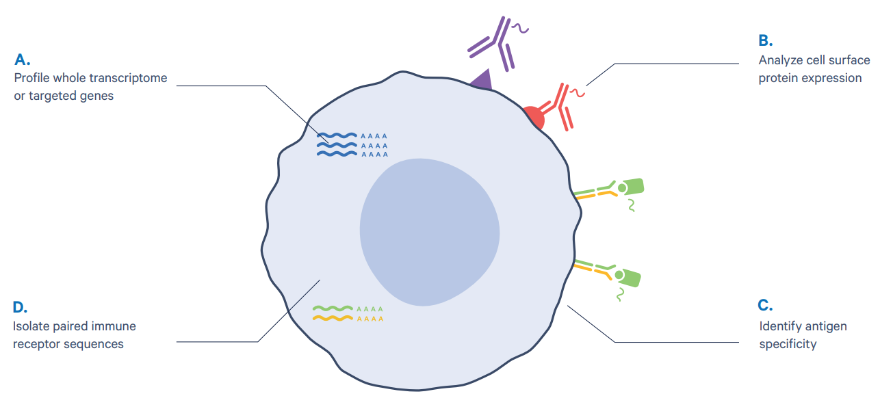


Conventional sorting yields limited information
Anti-CD19
CD19
Anti-CD20
CD20
Bait 1
HIV ENV trimers
Bait 2

Slide 34




The LIBRAseq approach make use of oligonucleotide barcodes
Anti-CD19
CD19
Anti-CD20
CD20

Slide 35

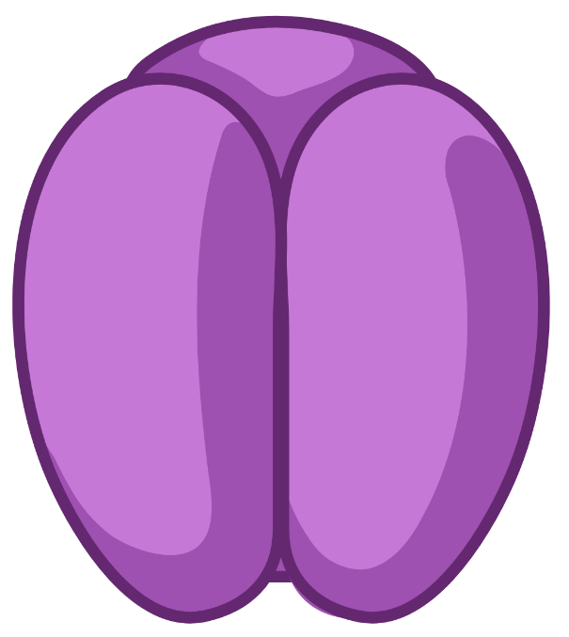








LIBRAseq : an almost limitless number of baits can be used
Anti-CD19
CD19
Anti-CD20
CD20
Large-breadth
B cell

Slide 36
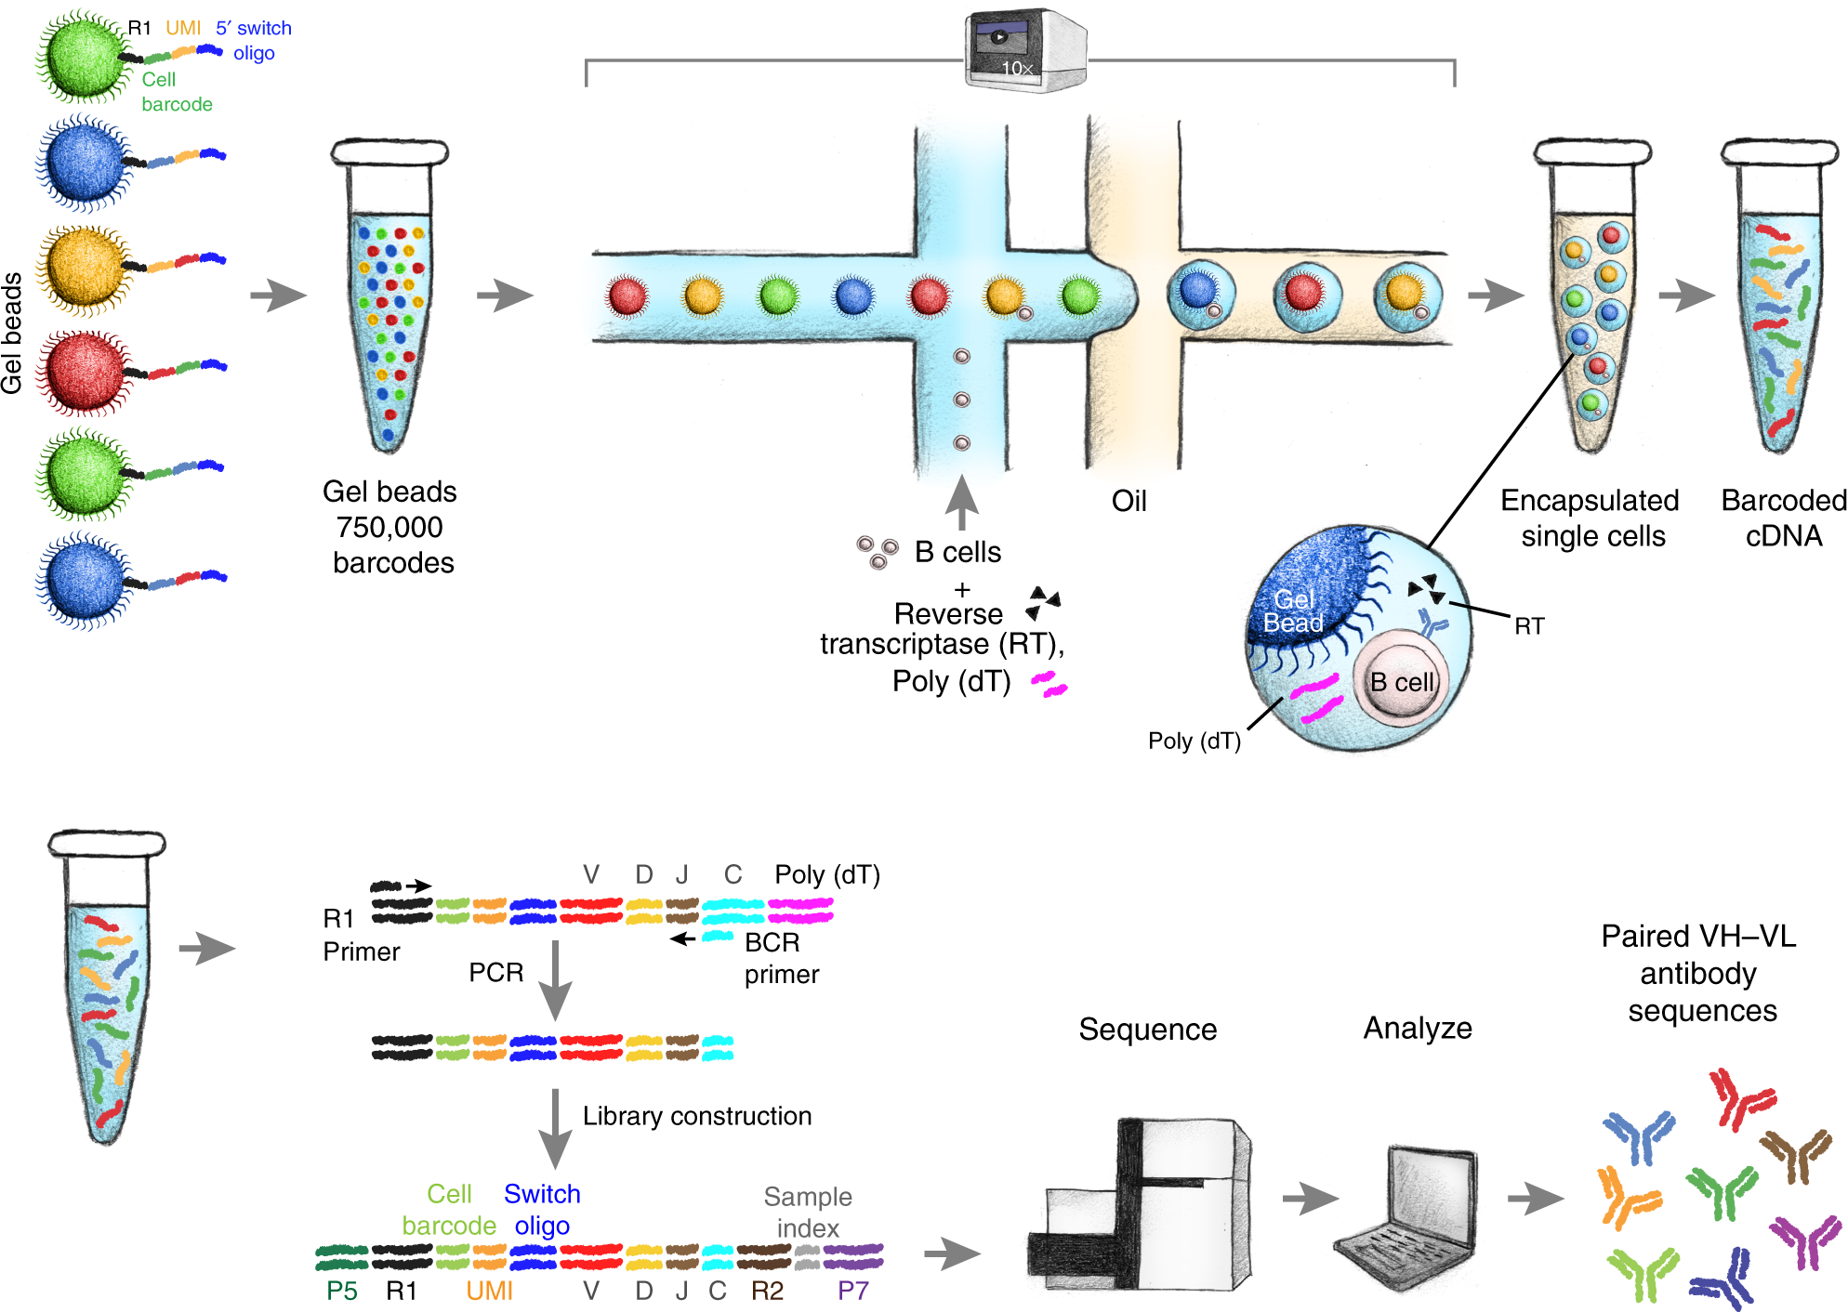

LIBRAseq uses microfluidics to barcode single cells

Slide 37

LIBRAseq : second-stage barcodes link markers and mRNAs to individual cells
Anti-CD19
CD19
Anti-CD20
CD20
Large-breadth
B cell

Slide 38
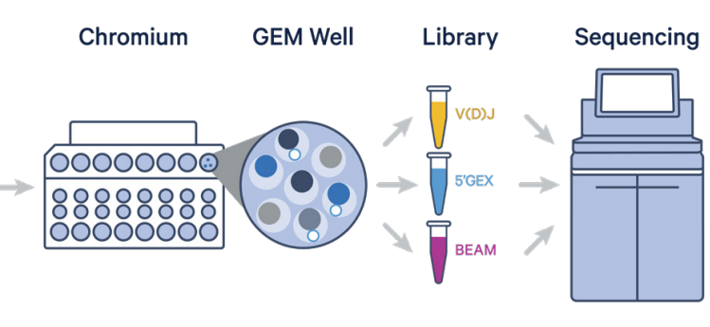
High-throughput sequencing is key to reading all these barcodes

Slide 39
Single-cell sorting vs LIBRAseq
FACS single-cell approach
LIBRAseq technique
Fluorophore
Barcode
Low throughput
High throughput
Low recovery
High recovery
Limited surface markers
~Unlimited surface markers
No cell transcriptome information
Cell transcriptome recovery

Slide 40
LIBRAseq : more cells and more information per cell

Slide 41
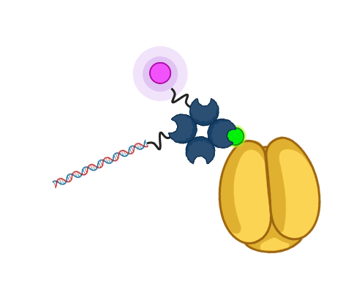
Baits are complex structures : HIV Env trimers can vary in conformation
Trimer of gp120
Biotin
DNA barcode
Streptavidin
Cai et al, PNAS 2017 (http://dx.doi.org/10.1073/pnas.1700634114)

Slide 42
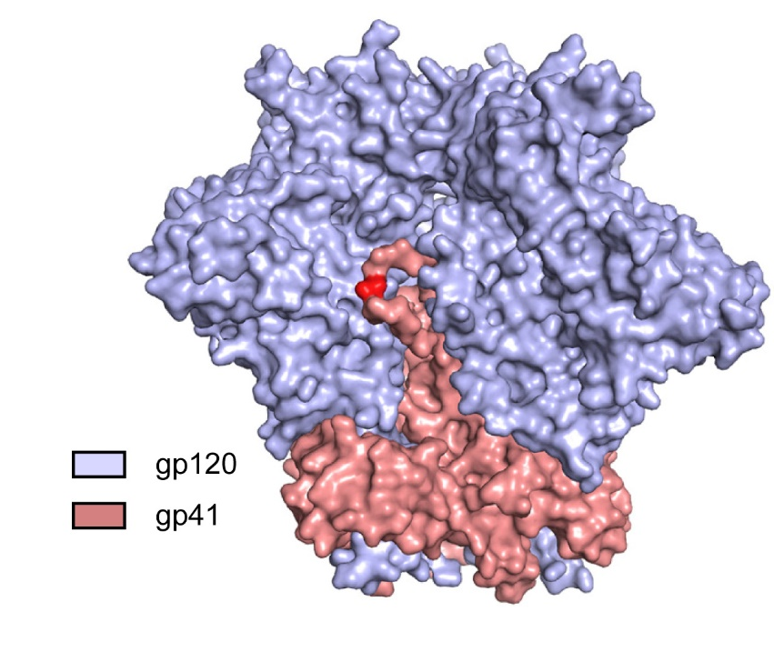

Baits are complex structures : HIV Env trimers can vary in conformation
Trimer of gp120
Biotin
DNA barcode
Streptavidin
Cai et al, PNAS 2017 (http://dx.doi.org/10.1073/pnas.1700634114)
Joyce et al. Cell reports 2017 (https://doi.org/10.1016/j.celrep.2017.11.016)

Slide 43
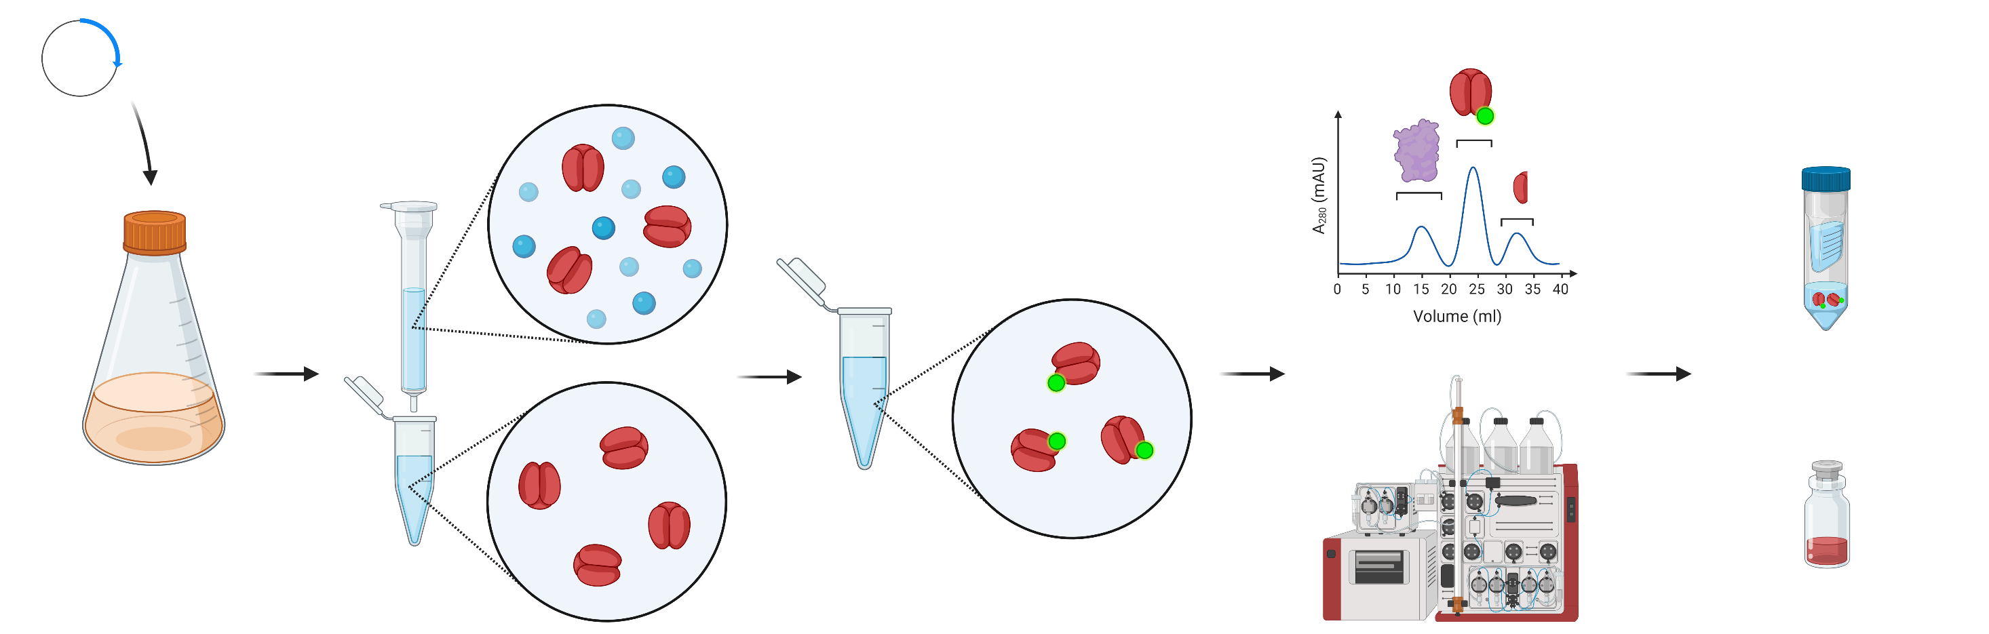
HIV Env trimer production is a lengthy journey
Modified Env gene
Concentration
In-vitro biotinylation
HEK 293F cells
Storage
-80°C
Purification
Immunoaffinity column
Purification
SEC column

Slide 44

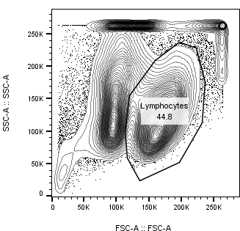
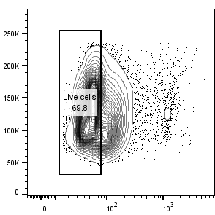
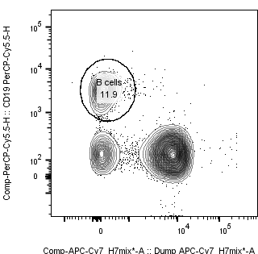
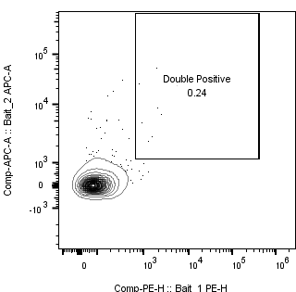
HIV Env trimer characterization
Name: BG505_T332N
Origin: Heterologous
Construct type: SOSIP
Mol. weight: 220 kDa
Date of prod.: 08-Jul-2022
Aliquot color: red/pink
Antigenicity: Ok
BLI date: 29-Aug-2022
FACS: Ok
FACS date: 17-Aug-2022
Conformation: Ok
 | F105 | Den3 | NC-Cow1 | VRC01 | PG16 | PGT145 | PGT121 | PGT128 | PGT151 | 4E10
Epitope | Gp120 | (-) ctrl | CD4 BS | CD4 BS | V2-apex | V2-apex | V3 | V3 | Interface | MPER
Expected (IC50) | NN | NN | 0.01 | 0.085247 | 0.008 | 0.083 | 0.0104 | 0.02848 | undetermined | undetermined
Measured | Ø | Ø | ++ | + | ++ | ++ | + | +++ | +++ | ++
Final decision:
 Ok to use
 Discard

Slide 45

Creating soluble trimeric ENV chimeras to expose native epitopes
Gp120 strain | Produced?
92BR020
BG505 WT
BG505 T33N
CE0217
CNE8
CNE55
IAVI c22
JRCSF
JRFL
PC94 v12 c007
PC94 v18 c046
PC94 v48 c028
PC94 v60 c037
PC94 v78 c040
H
A
Joyce et al. Cell reports 2017 (https://doi.org/10.1016/j.celrep.2017.11.016)
Notes:
Dire pourquoi on a besoin de trimères natifs

Slide 46


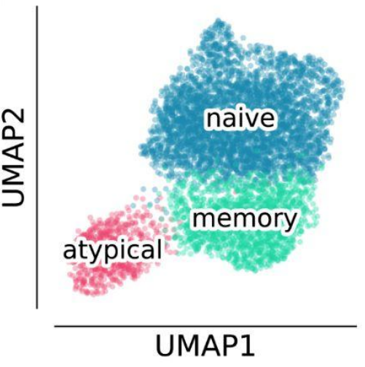
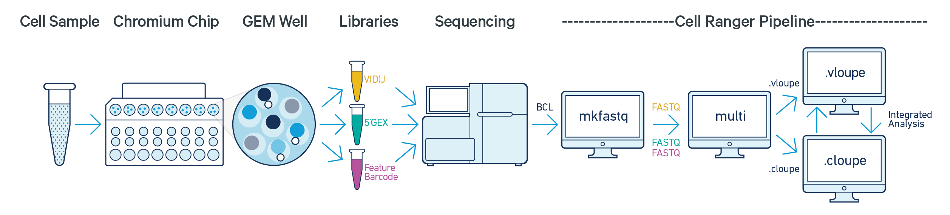
Practical aspects of the single-cell sorting protocol
Stain
Enrichment
FACS-based
<- - - - - - - - - - - - Scab Ranger - - - - - - - - - - - - >
Sequencing
Libraries
GEMs emulsion

Slide 47
B cells from 8 timepoints were analyzed
HIV
infection
18
24
30
36
42
48
54
60
66
72
78
months post infection

Slide 48
B cells from 8 timepoints were analyzed
HIV
infection
18
24
30
36
42
48
54
60
66
72
78
months post infection

Slide 49
B cells from 8 timepoints were analyzed
HIV
infection
18
24
30
36
42
48
54
60
66
72
78
months post infection

Slide 50
B cells from 8 timepoints were analyzed
- Alive
- CD3⁻/CD14⁻
- CD19⁺/CD20⁺
- eventually CD27⁺
HIV Env specific B cells
- Alive
- CD3⁻/CD14⁻
- CD19⁺/CD20⁺
- HIV positive
All B cells
HIV
infection
18
24
30
36
42
48
54
60
66
72
78
months post infection

Slide 51
These B cells came from all sampled timepoints

Slide 52
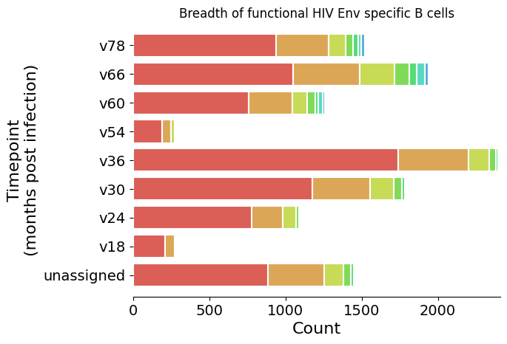
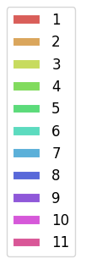
Some of these B cells could bind a broad spectrum of HIV Env trimers

Slide 53
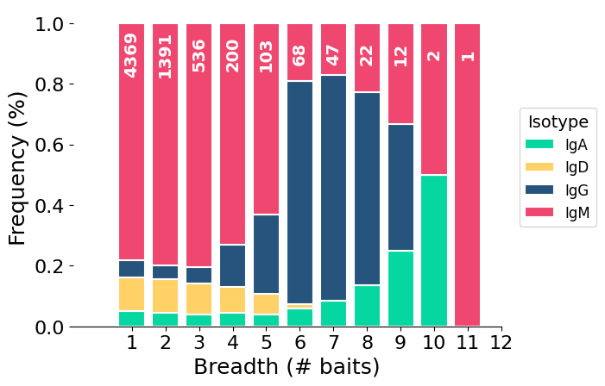
Differential use of isotypes according to breadth of binding

Slide 54
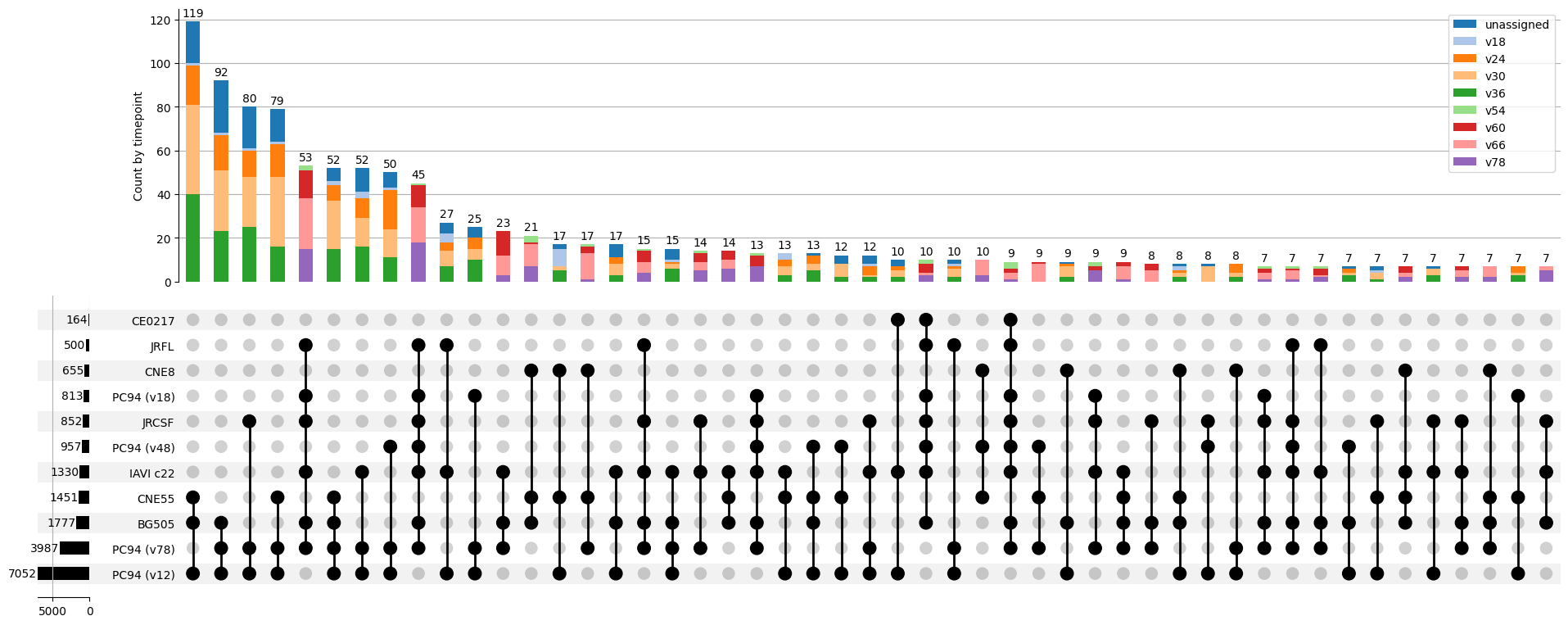
Individual B cells exhibits various degrees of binding against baits

Slide 55
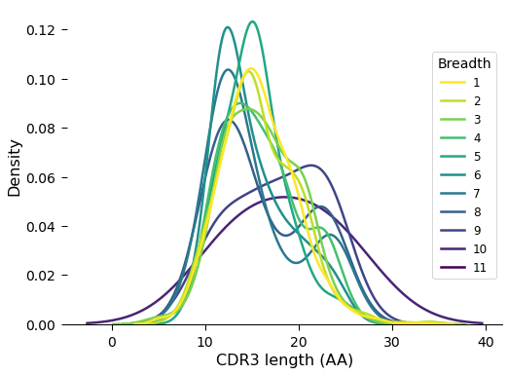
Key metrics, such as CDRH3 length, can be assessed on a repertoire scale

Slide 56
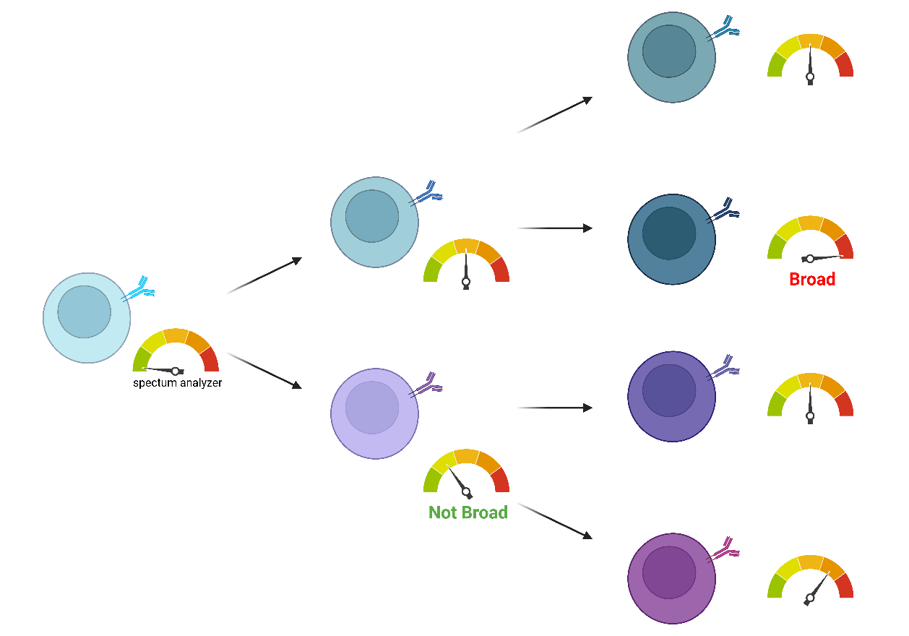
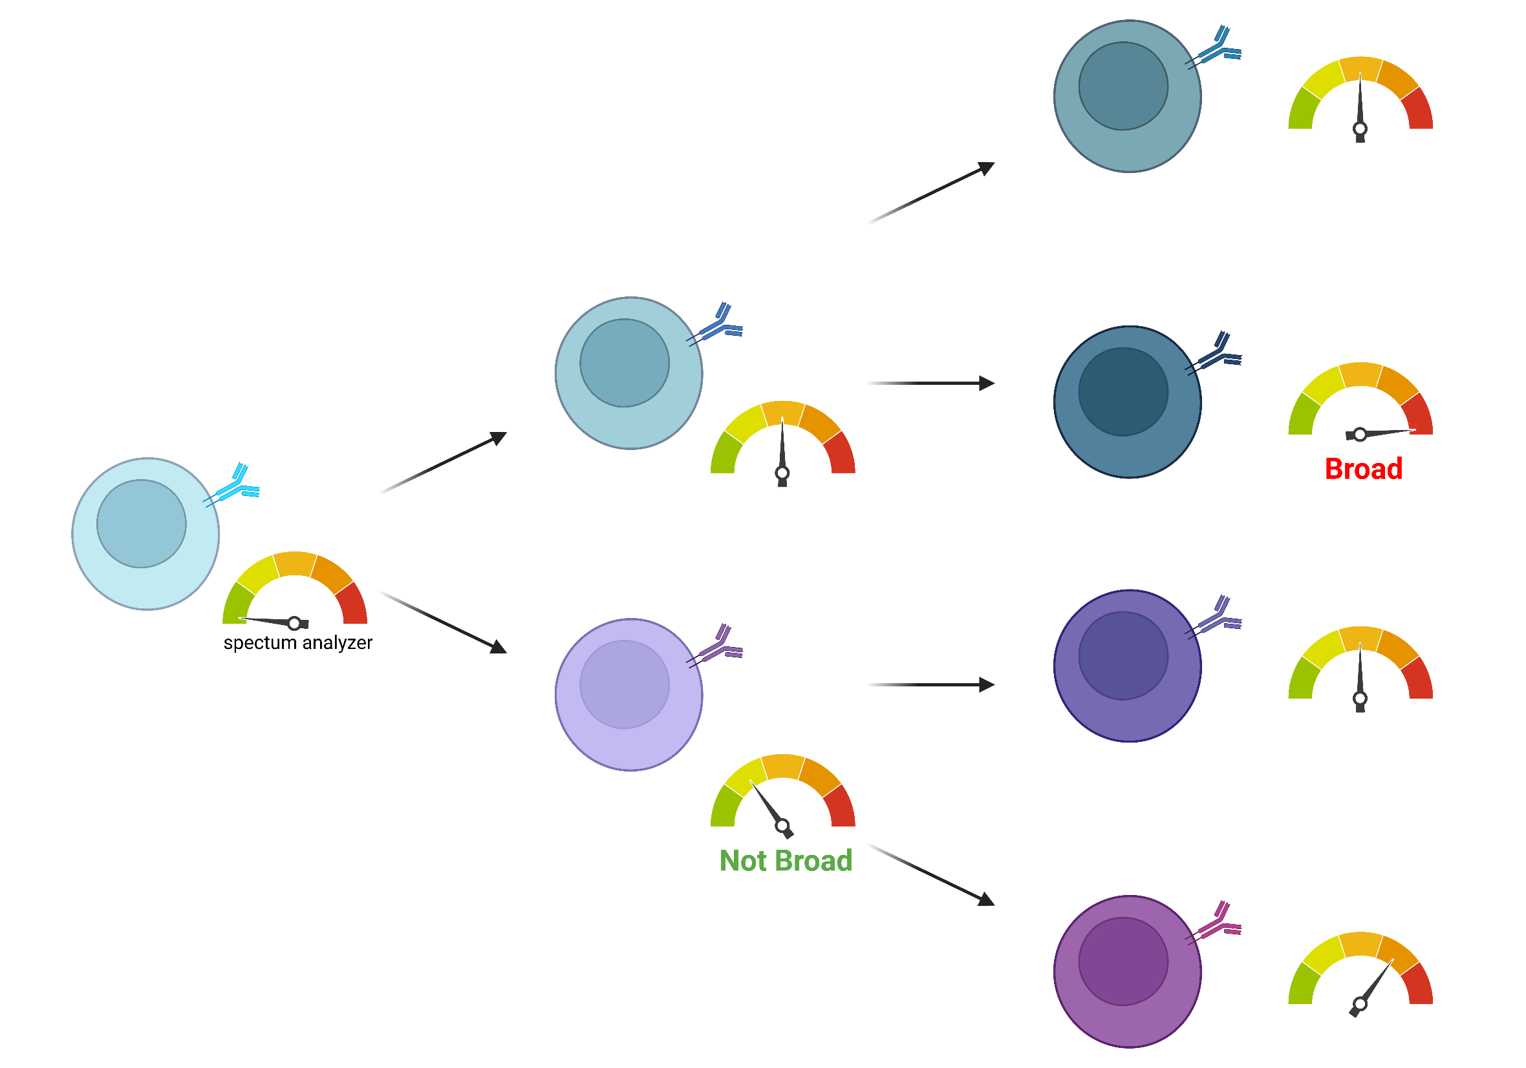



B cells expand in clonal lineages after activation
Naive B cell
Matured B cells

Slide 57


Large scale criterias guide the selection of mAbs to be produced and tested
Best
individual
binders
Interesting
binding
patterns
Lineages
of
interest

Slide 58





Production of mAbs allows for functional testing (neutralization assays) of antibodies from isolated B cells

Slide 59

Entire lineages can be caracterized based on the neutralization activity of their mAbs against a panel of viruses

Slide 60

Some isolated antibodies exhibit large breadth of neutralization along with great potency

Slide 61
A few take home messages
The single-cell approach is highly rewarding, yielding more information for each cell
This techniques allows for the exploration of immune repertoires in unprecedent depth and with a hight throughput
For our donor PC94, a single lineage seems to be responsible for the outstanding neutralization activity of the sera
The entire transcriptome of each cell is available… coming soon!

Slide 62
Acknowledgments
Poignard Lab
Pascal Poignard
Marlyse Buisson
Isabelle Bally
Sebastian Dylon
Romy Rouzeau
Claire Rousset
Axelle Amen
Laurence Grossi
Giovanna Clavarino
Burton Lab
Dennis Burton
Pilar Altman
Mara Parren
Rebecca Nedellec
Nathan Beutler
Briney Lab
Bryan Briney
Jonathan Hurtado
Terrence Messmer
Pragati Sharma
Andrabi Lab
Raiees Andrabi
Sophie Ge Song
Katharina Dueker
Sean Callaghan
Tazio Capozzola
Sok Lab
Devin Sok
Elise Landais
Romy Rouzeau
Iszac Burton
Claudia Flynn
Katie McKenney
Alison Burns
Ward Lab
Gabriel Ozorowsky
Wilma Lee
Wilson Lab
Rotimi Omorodion

Slide 63
Thanks for you attention!

Slide 65


Some gene usages are enriched in the HIV Env specific fraction

Slide 66





And there’s a lot more to it!

Slide 68


How?
HIV
gp41
Trimer of gp120

Slide 69
How?
Fluorophore
Streptavidin
DNA barcode
Biotin
Trimer of gp120
Illumina adapter

Slide 70


How?
BCR
B cell

Slide 71


Experimental design: fishing antibodies!

Slide 72



How?
Stain
Enrichment
Or
<- - - - - - - - - - - - Scab Ranger - - - - - - - - - - - - >
FACS-based
MACS-based
<- - - - - - - - - - - - Cell Ranger - - - - - - - - - - - - >
Sequencing
Libraries
GEMs emulsion

Slide 73

A novel approach of single-cell analysis: LIBRAseq

Slide 74
Complete phylogeny of a neutralizing lineage can be reconstructed, revealing the evolutive path to broad neutralization

Slide 75
Where is my shot?
COVID-19

Slide 76
Where is my shot?
COVID-19
HIV | AIDS
Numerous clinical trials wihtout any success
Years 1990-2010
1983
2009
2016
RV144 Trial
31 % efficacy in a Thai clinical trial
HVTN100 Trial
30 % efficacy in subgroups in a South-African cohort

Slide 78

We need to understand the arms race between the immune system and the HIV
Prime Boost
Breadth & Potency
UCA
UCA

Slide 79

The human antibody repertoire exhibit an astonishing diversity
Total antibody diversity is estimated to be around
10¹⁸ possibilities
Briney et al, Nature 2019 (https://doi.org/10.1038%2Fs41586-019-0879-y)

Slide 80
PC94 is an outstanding neutralizer from a longitudinal cohort

Slide 82

PC94
1
2
3
Early timepoints
Late timepoints
HIV
infection
18
24
30
36
54
60
66
78
months post infection

Slide 83


